Slide 1

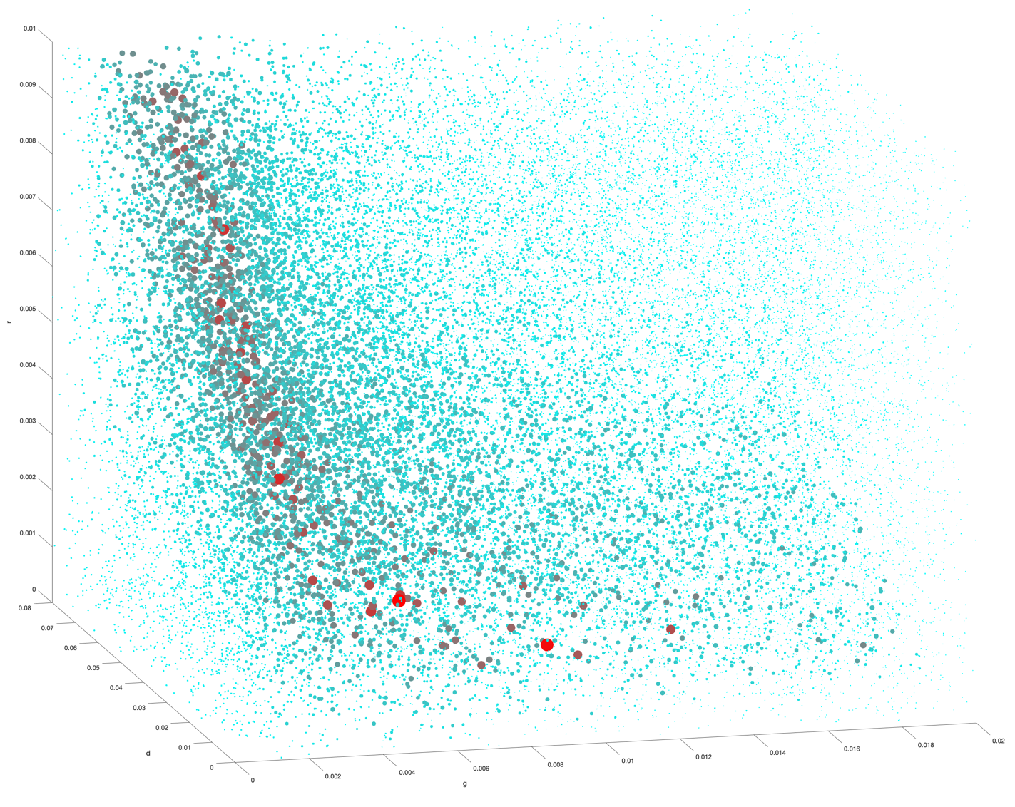
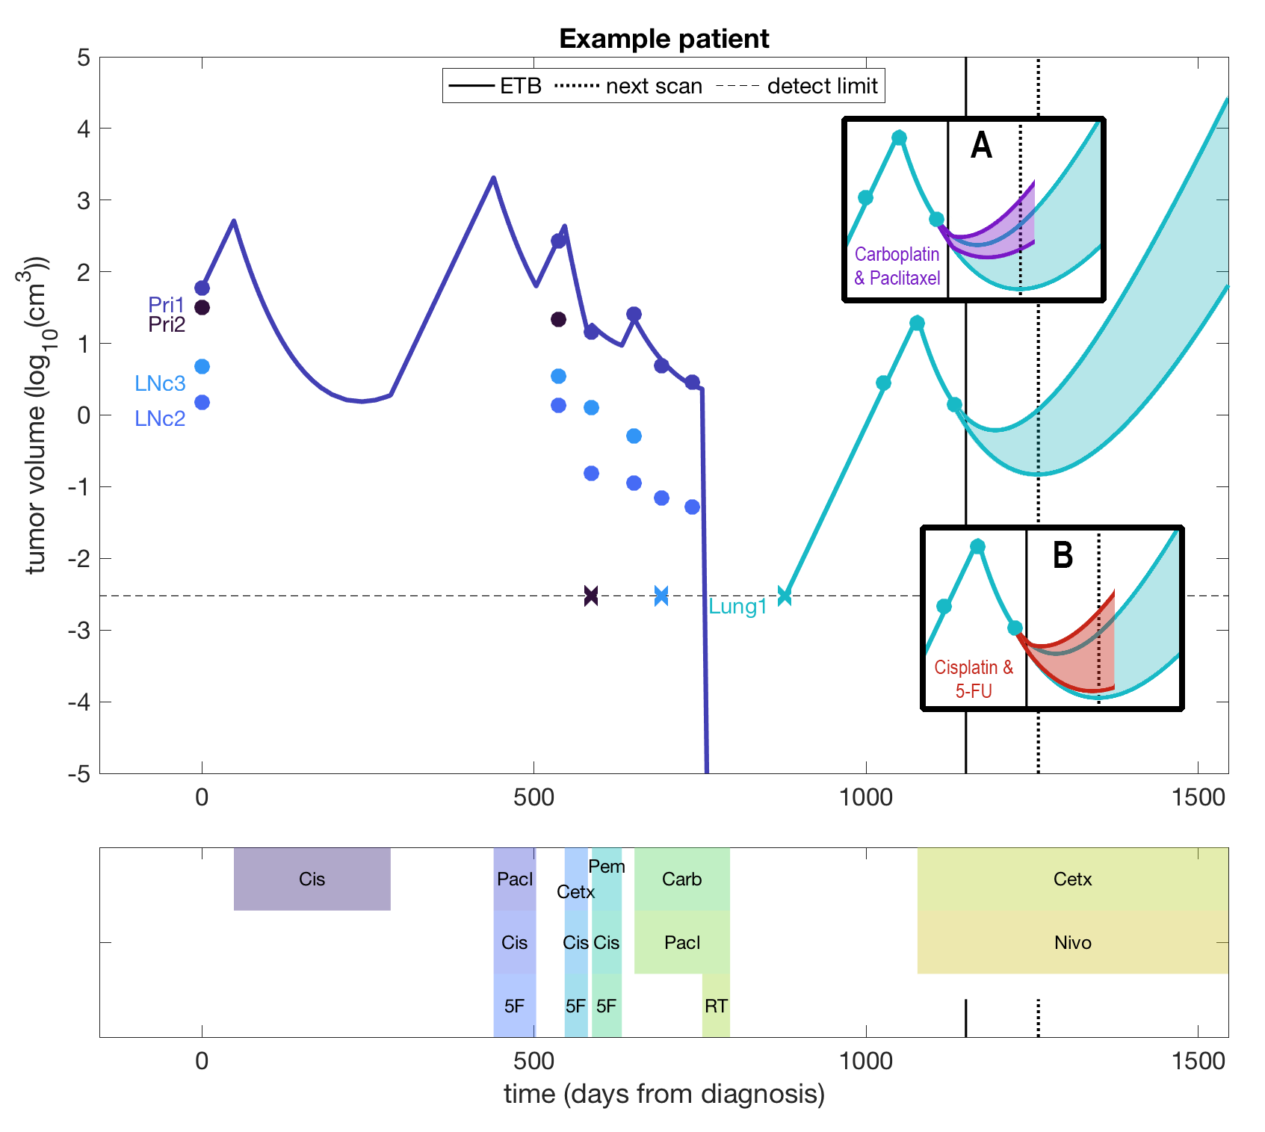
Virtual Patient Cohorts
MRT
IMAT
4.11.25

Slide 2
Virtual patients
Can we predict exact outcomes for an individual patient?
No.
Will we ever be able to?
No.

Slide 3
Virtual patients: a cohort-based approach
General principle:
Quality patient data
Biological understanding
Appropriate mathematical model
Statistical analysis
Informative output
Apply to:
Individual patient care (decision support)
Clinical trial design
Biomarker discovery
Pre-clinical translation
Model calibration/validation
Etc.

Slide 4
Virtual Patients for individual clinical care

Slide 5



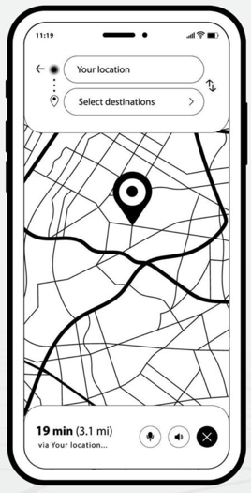
The history of navigation has similarities with cancer treatment
Exploration and discovery of the treatment landscape
Wide variety of treatment, low success, high toxicity
No predictive power
Standards of care for broad disease types/subtypes based on diagnosis
One-size-fits-all means wide range of outcomes
Statistical, cohort-based predictive power (static and not personalized)
Current Standard
Of Care
Personalized medicine using molecular markers
Improved outcomes and smaller deviations for those within identified molecular subtypes
Statistical, subcohort-based predictive power (personalized, but mostly static)
Real-time, dynamic decision support based on longitudinal data
Optimized outcomes based on continuous response analysis and novel data
Individual-based predictive power (personalized and dynamic)
Proposed
Product

Slide 6
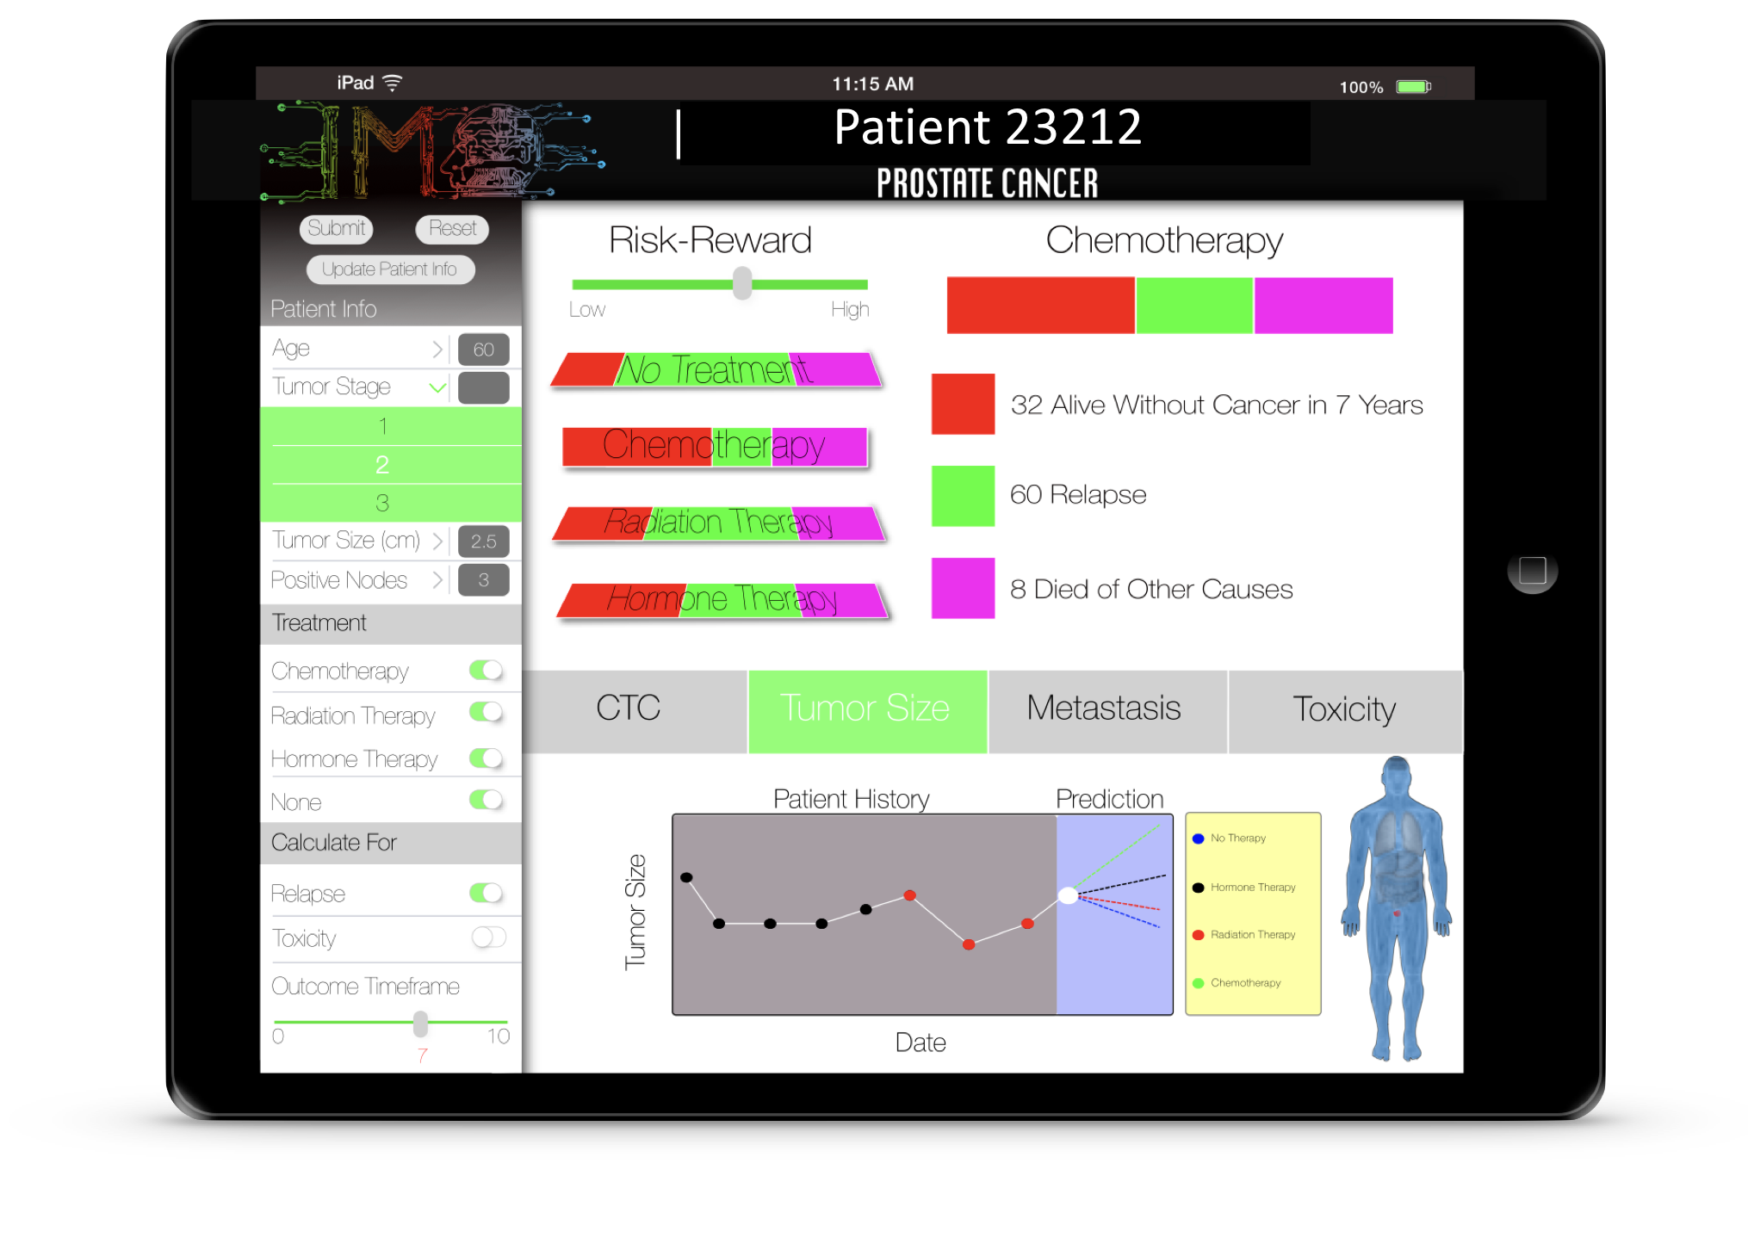
Can we build a treatment navigation system for different cancer types?
Cancer is much more complex than road navigation, but the same approaches can be used
A good system will be:
Human-centered, to account for patient and clinician preferences
User-friendly, to be broadly practical in SOC
Adaptable, to rapidly incorporate new modalities and knowledge
Rapid, to provide timely decision support
Intuitive, to enhance clinical practice rather than replace aspects of it
Validated, so that patient care is maximized, and regulatory hurdles are surpassed
Scalable, to reach many patients
Flexible, to accommodate differences in access to care, financial resources, and unexpected changes
Modular, to accommodate specific aspects of each disease type
To develop such a framework, many disciplines need to be integrated and funded

Slide 7


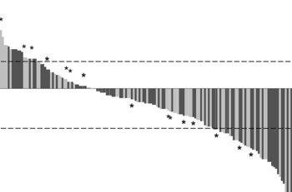
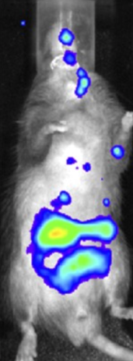
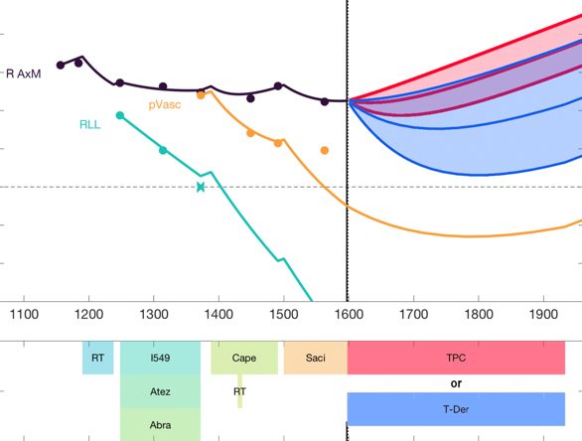
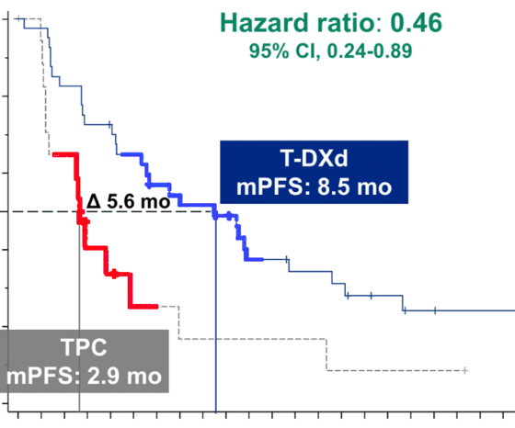
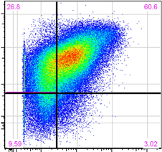
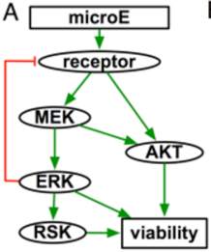
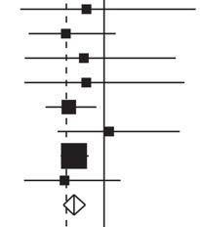
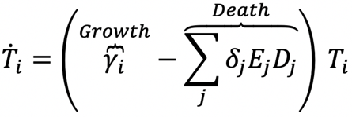
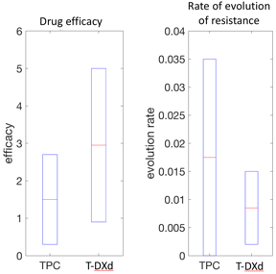
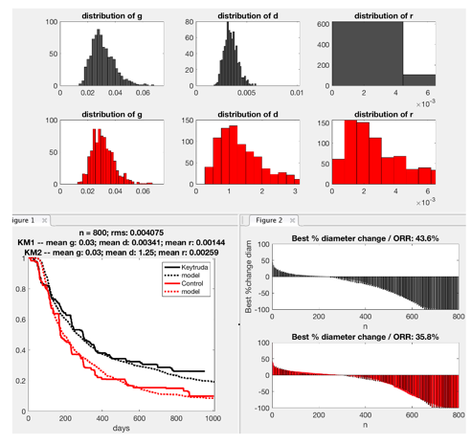

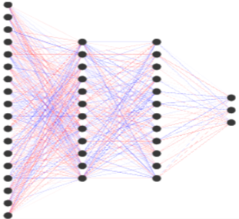
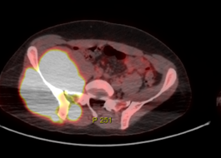
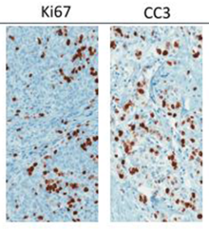


Building a modular translational system
Output: Decision support
Patient-specific outcome predictions
Optimized therapy options
Continuous dynamic follow-up
Software:
Disease-specific module
Clinical data
Operating system: Tools
Biological & Epidemiological knowledge
Data mining & analysis
Virtual “Phase-i” trials
Statistical & ML methods
Risk-reward analysis
Predictive Optimization
Visualization
Experimental
data
Mathematical models
Input: Individual patient data
Demographic & epidemiological
Cancer & treatment history
Lesion locations & sizes
Blood-based biomarkers
Histology of biopsies & resections
Genetic & epigenetic signatures
Outcome goals & available therapies
PROs & QOL considerations
Power: Funding
Institutional trial support
Grant funding
Industry & capital partnership

Slide 8


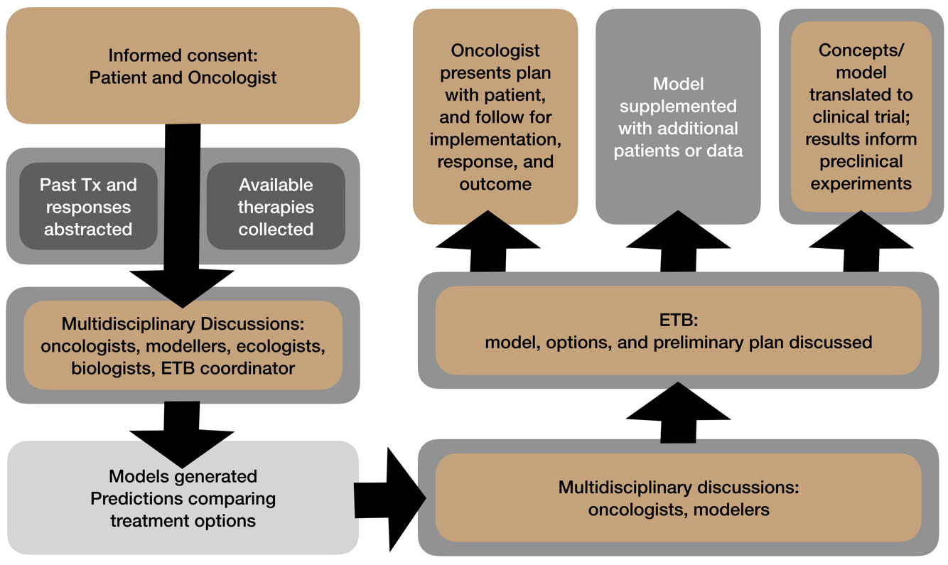

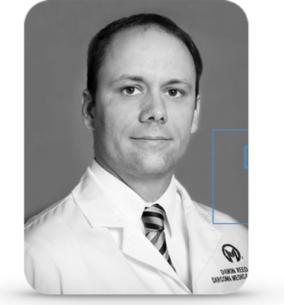


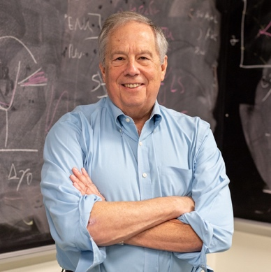
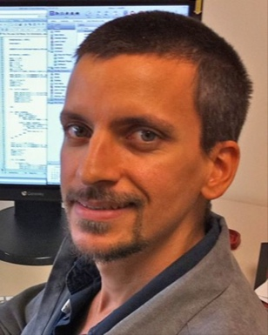


How to start building and integrating the pieces: the Evolutionary Tumor Board
Pilot clinical trial (NCT04343365)
Christine
Chung
Damon
Reed
Bob
Gatenby
Mark
Robertson-Tessi
Jingsong
Zhang

Slide 9




ETB: Overarching framework & workflow
Develop mathematical models of disease dynamics using clinical and biological knowledge
Collect detailed, relevant, longitudinal data for the presenting patient
Calibrate a virtual “Phase i” trial using deep analysis of historical patient data and published cohort data for each potential agent
Predict outcomes for the patient across the therapy options amenable to the patient and their oncologist
Repeat the cycle upon patient follow-up

Slide 10



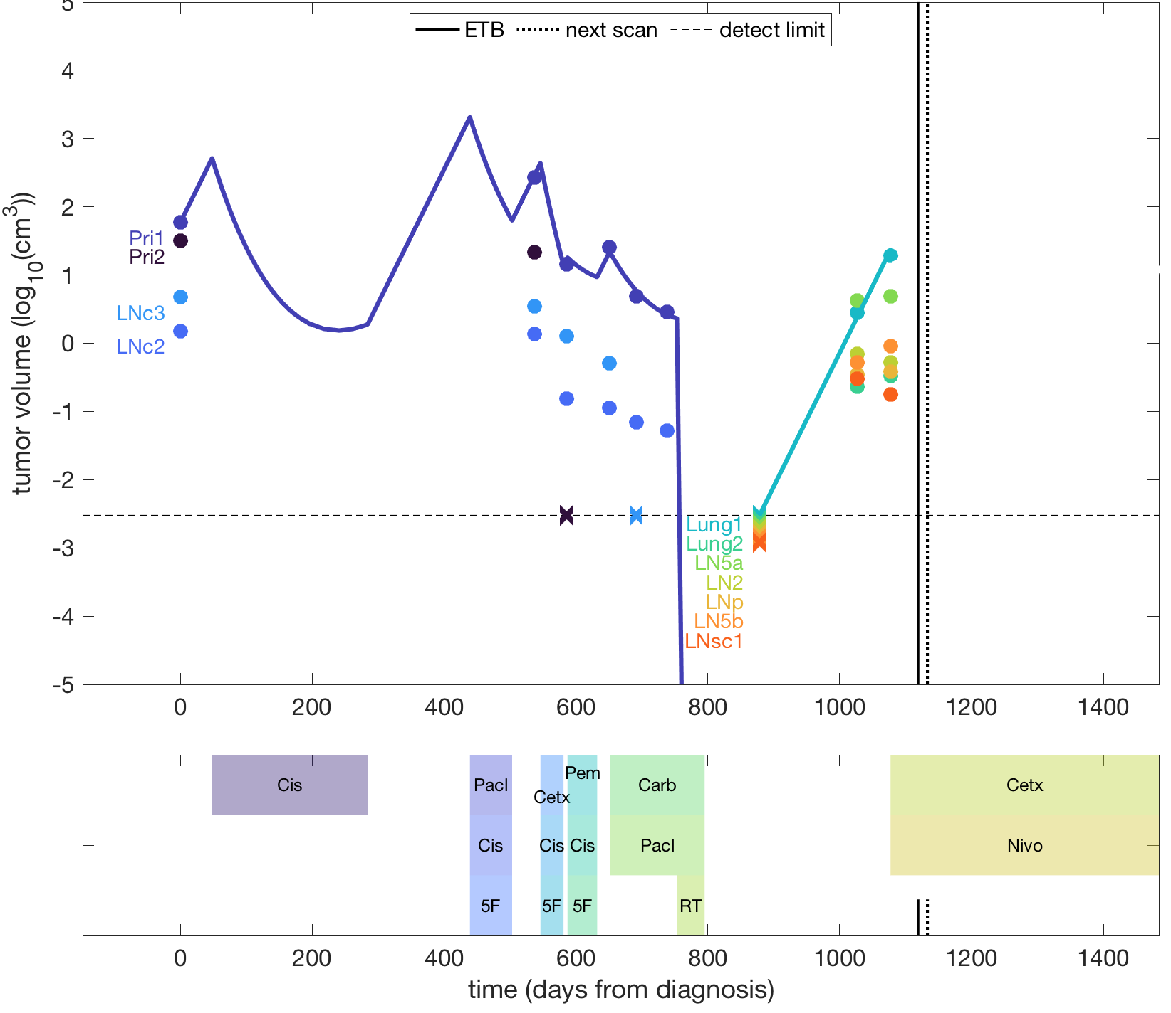
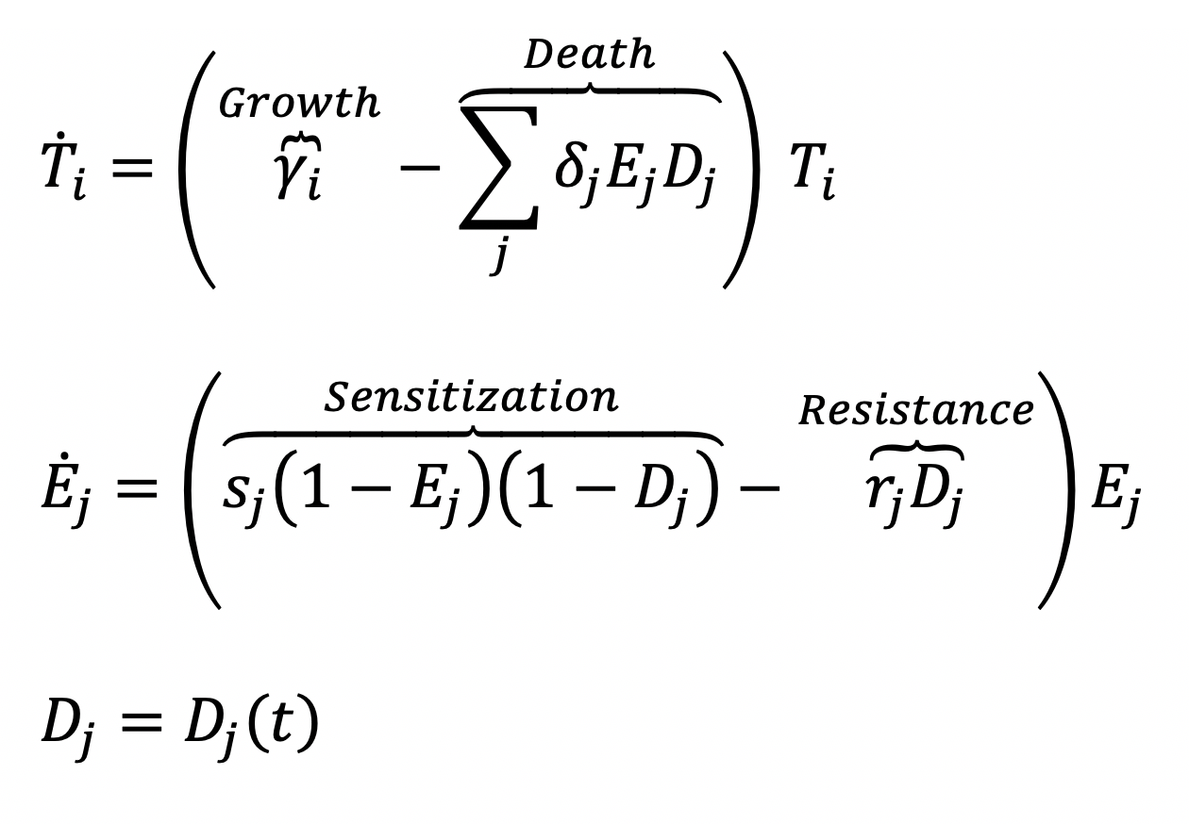
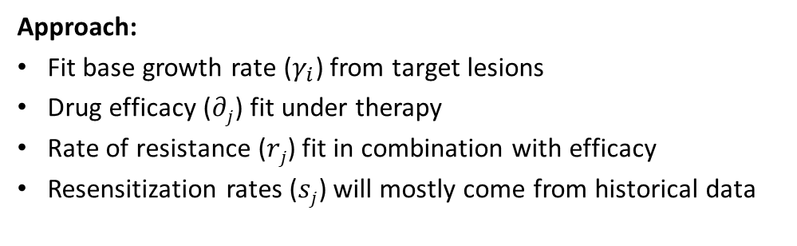
Modeling tumor dynamics in the patient (Head and Neck cancer)
Approach:
Fit base growth rate ($γ_{i}$) from target lesions
Drug efficacy ($∂j$) fit under therapy
Rate of resistance ($rj$) fit in combination with efficacy
Resensitization rates ($sj$) will mostly come from historical data

Slide 11
Historical patients & trial data are used to build the disease module
Retrospectively apply ETB workflow to historical cohorts in the same disease
Collect parameter ranges for growth rates, drug efficacy, rates of resistance and sensitization
Use these ranges prospectively for new patients on the ETB

Slide 12
Calibration sidenote:
Best fits
Individual representation of patients
Weighted fitting
Clouds of fitting around individuals
Distributional fitting
Abstracted parameter distributions
AI/ML
Black-box?

Slide 13
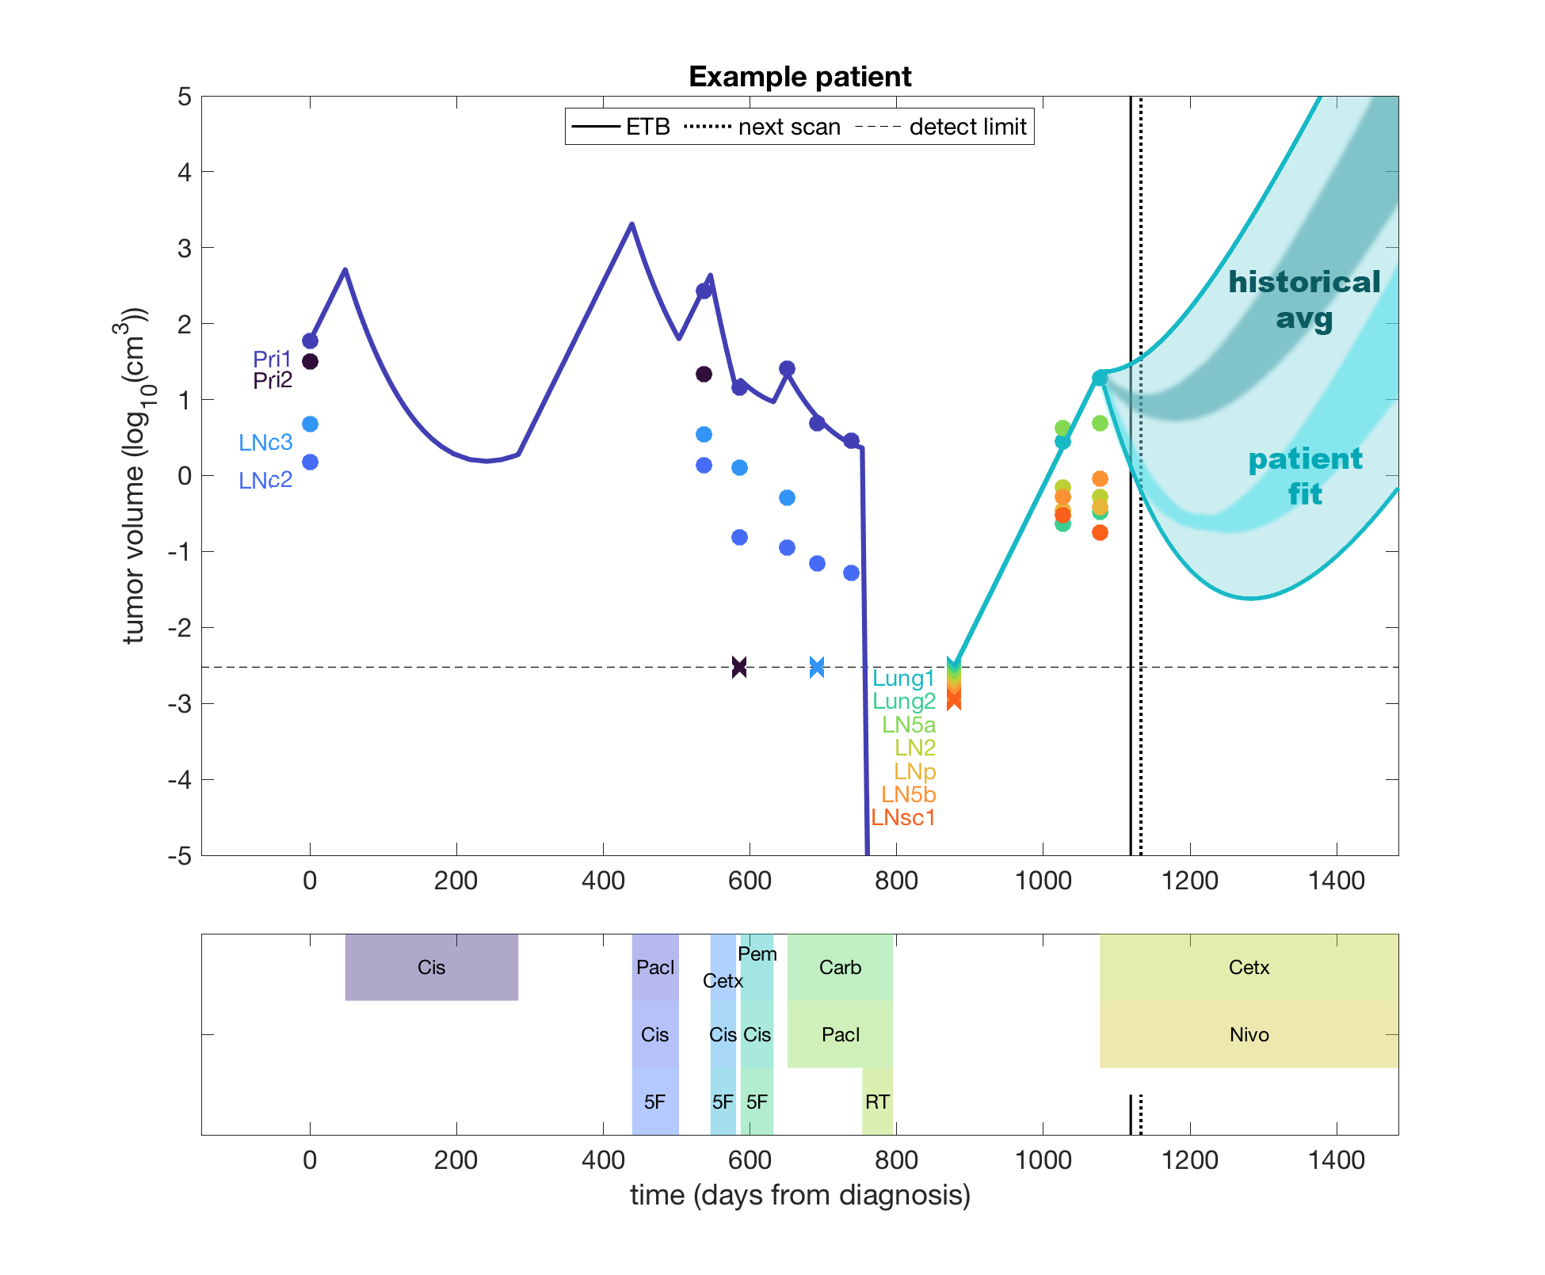

Predicting outcome ranges for therapy
Patient variation and uncertainties lead to a “cone” of predicted outcomes
Cone widely based on historical cohorts, then refined via patient-specific data

Slide 14
Decision support for multiple therapy options
Comparison of different therapies based on historical precedent can suggest outcome ranges
In this case, both chemotherapy options are not expected to improve outcomes over continuation of targeted therapy

Slide 15
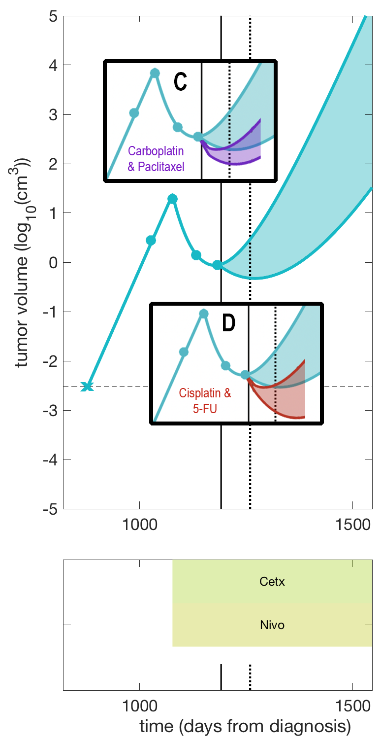
Repeated follow-up imaging informs the predictive model
After third scan, despite continued response, model suggests switching to chemotherapy soon

Slide 16
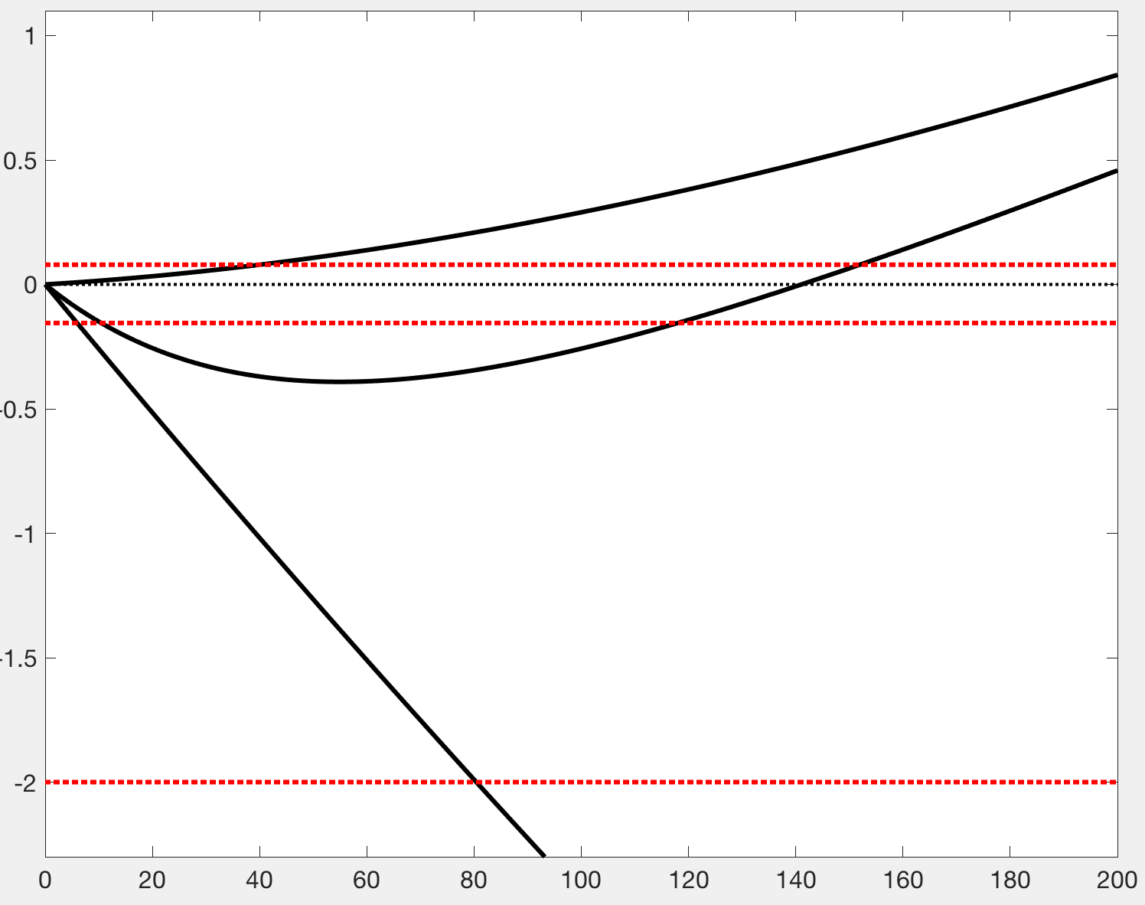
PFS curves and RECIST criteria (***varies by tumor type)
Complete Response (CR):
Disappearance of all target lesions
Partial Response (PR):
At least a 30% decrease in the sum of the LD of target lesions, taking as reference the baseline sum LD
Progressive Disease (PD):
At least a 20% increase in the sum of the LD of target lesions, taking as reference the smallest sum LD recorded since the treatment started or the appearance of one or more new lesions
Stable Disease (SD):
Neither sufficient shrinkage to qualify for PR nor sufficient increase to qualify for PD, taking as reference the smallest sum LD since the treatment started
PD
PR
PR
CR

Slide 17
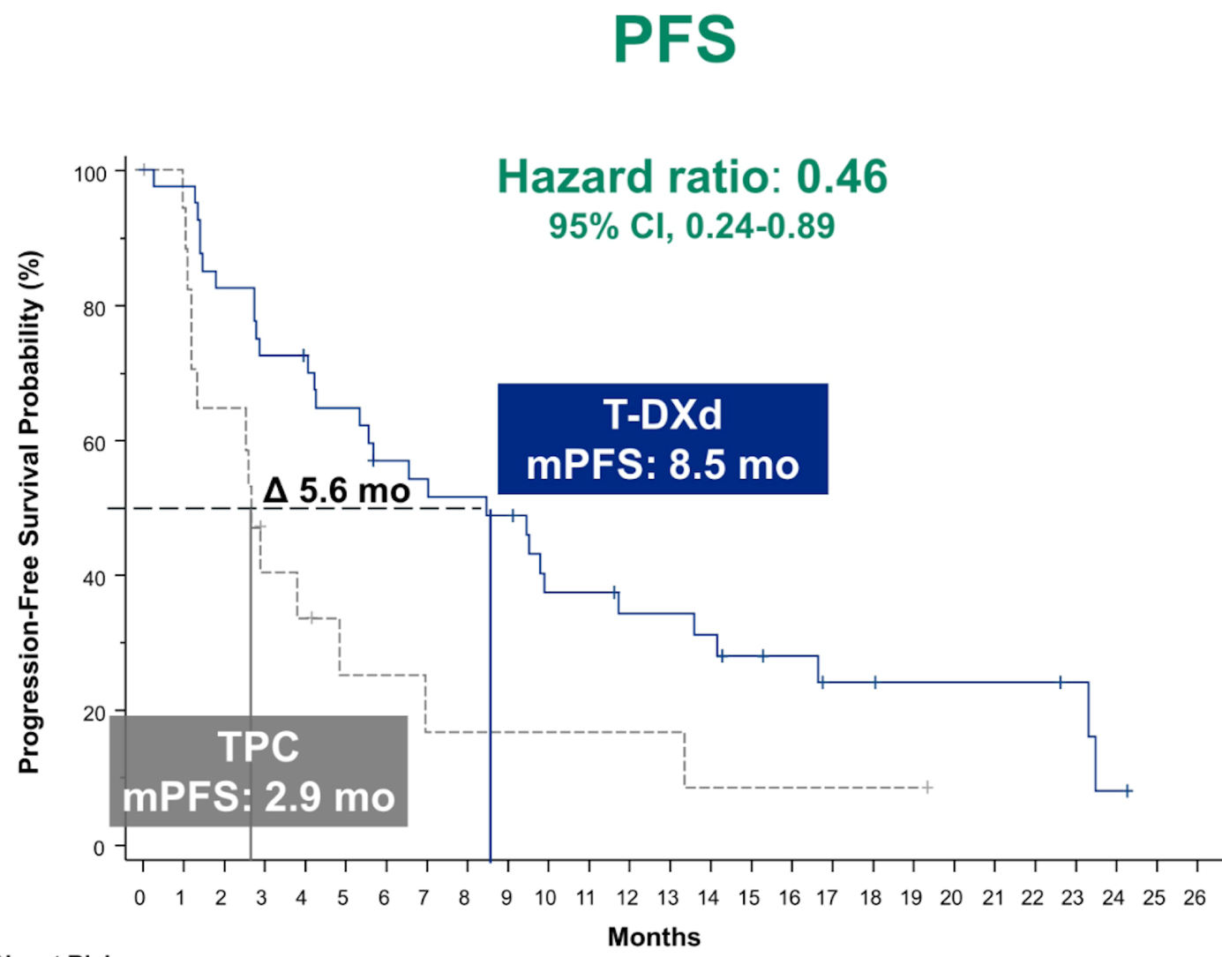
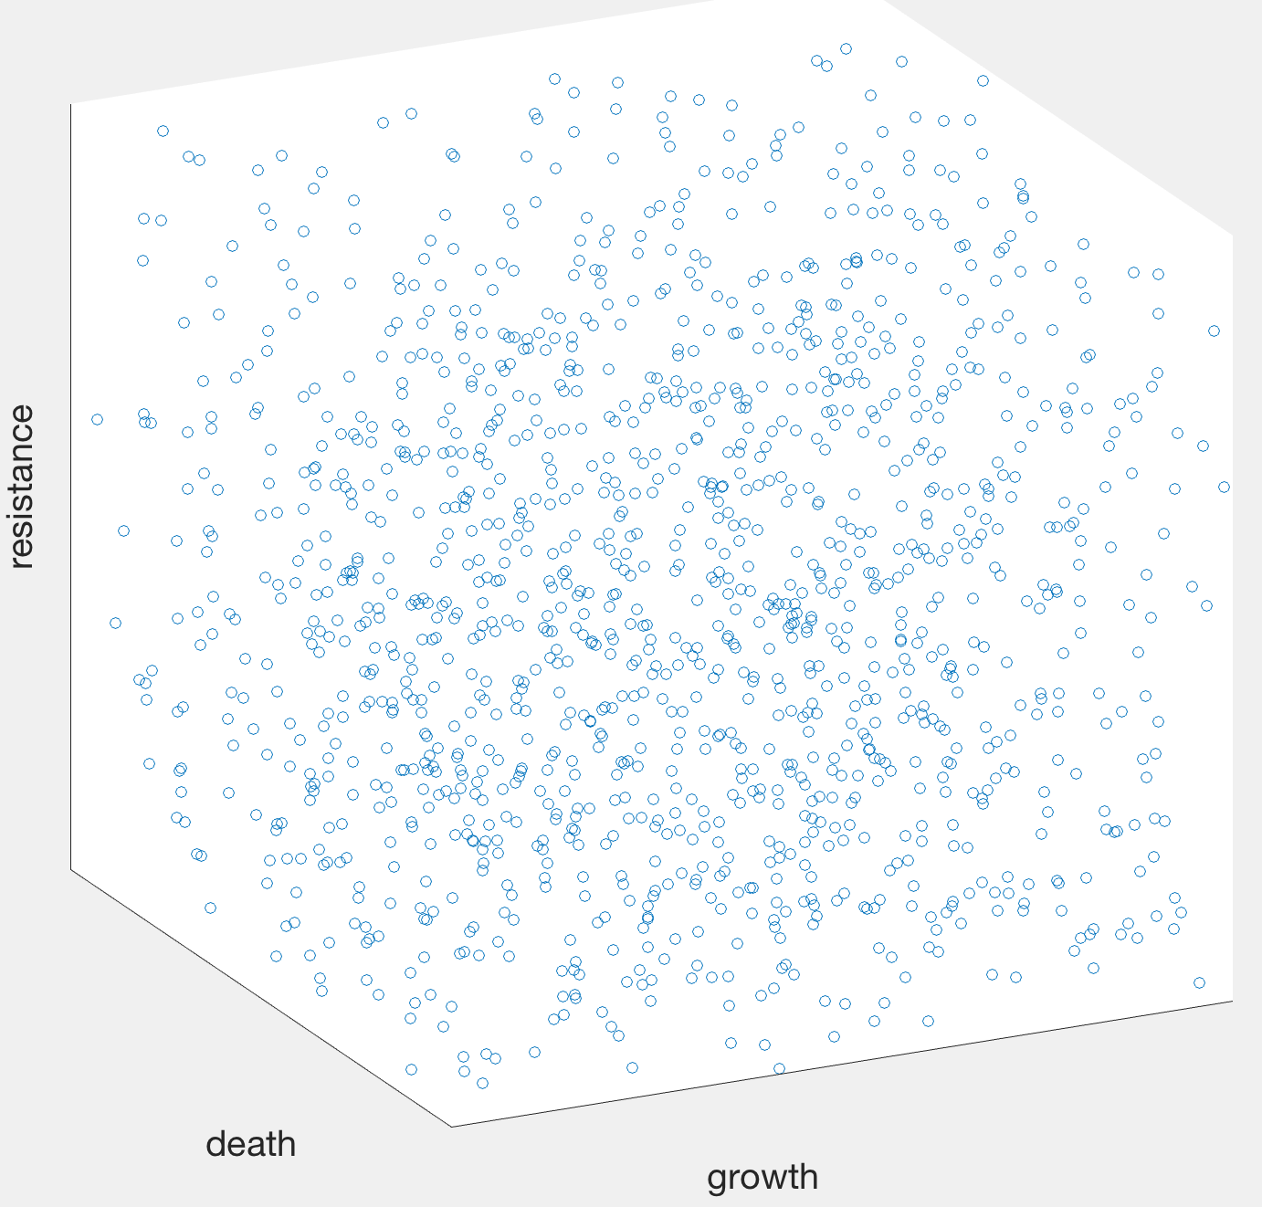
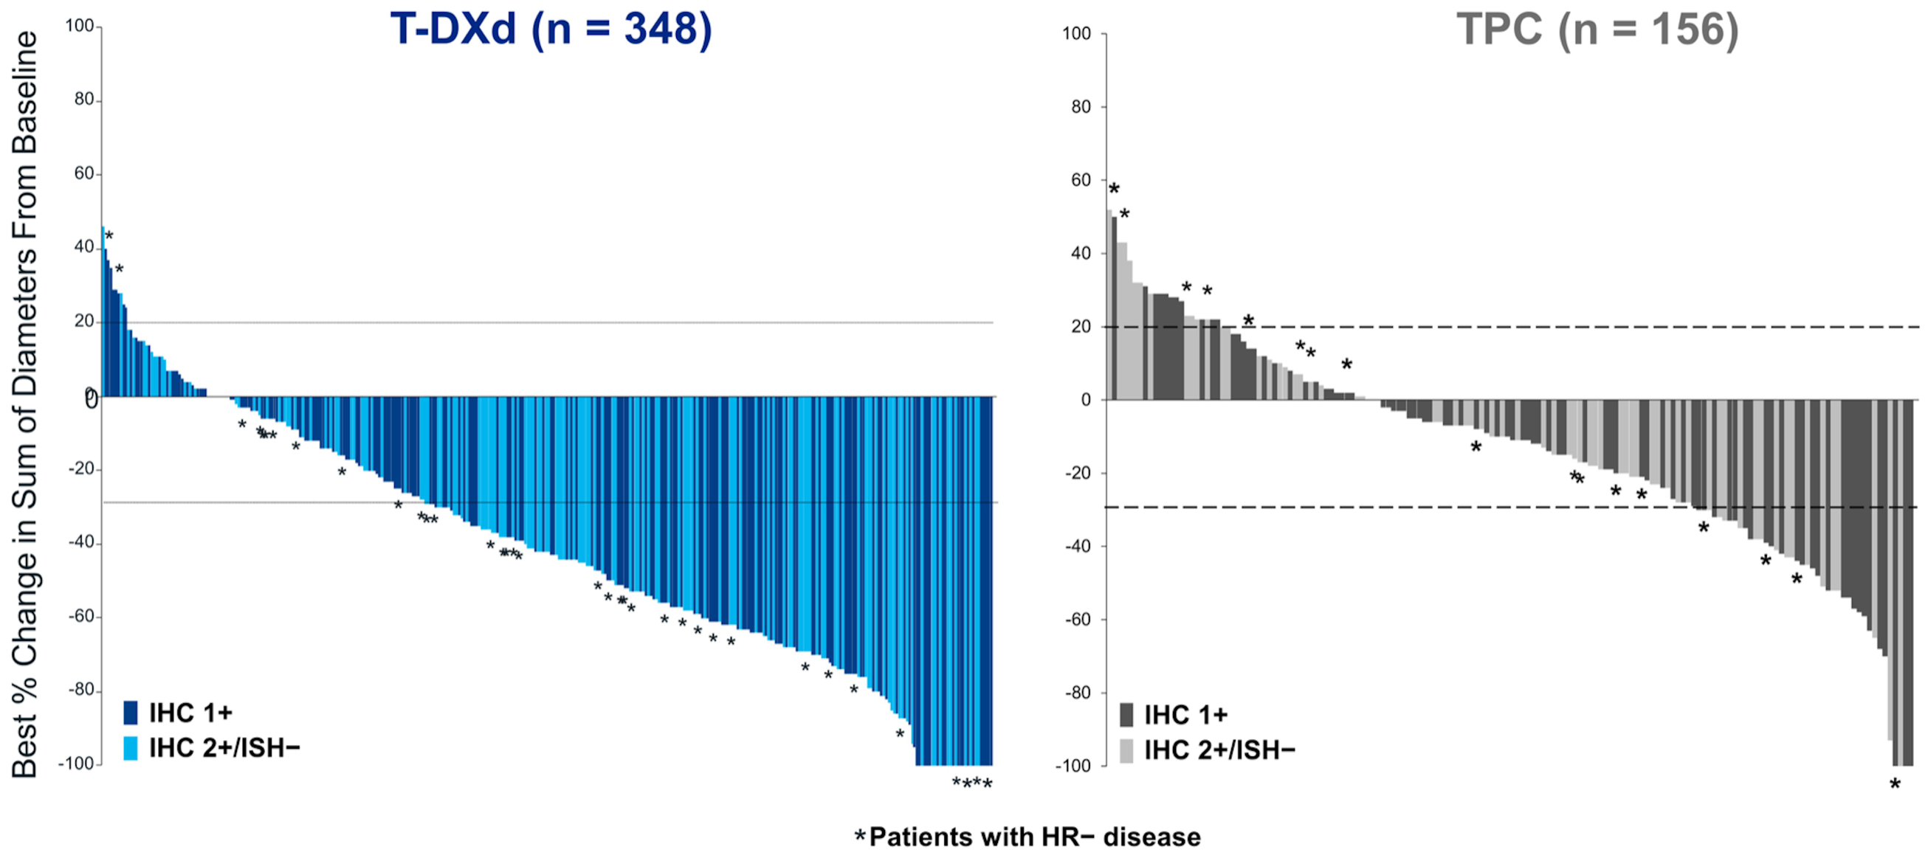
Virtual clinical trials
Build disease-specific, calibrated virtual patient databases
Use these databases as inputs to the framework, in combination with model fitting and individual patient data to develop patient-specific predictions
Virtual patient cohort

Slide 18
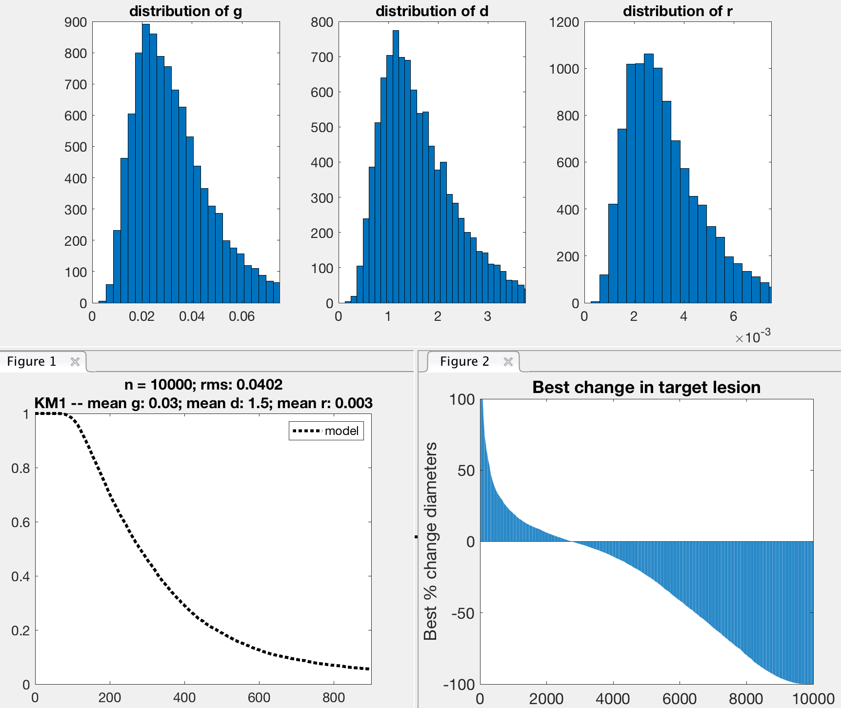
Output of the virtual trial
Parameter distributions for 10000 virtual patients
Distributions of parameters are taken from the log normal distribution:
Generate variable x from a normal distribution with mean and SD, and then calculate exp(x) to get the parameter
Advantage is that the values are always positive
Best response
compared to
Baseline (diam)
PFS Curve

Slide 19
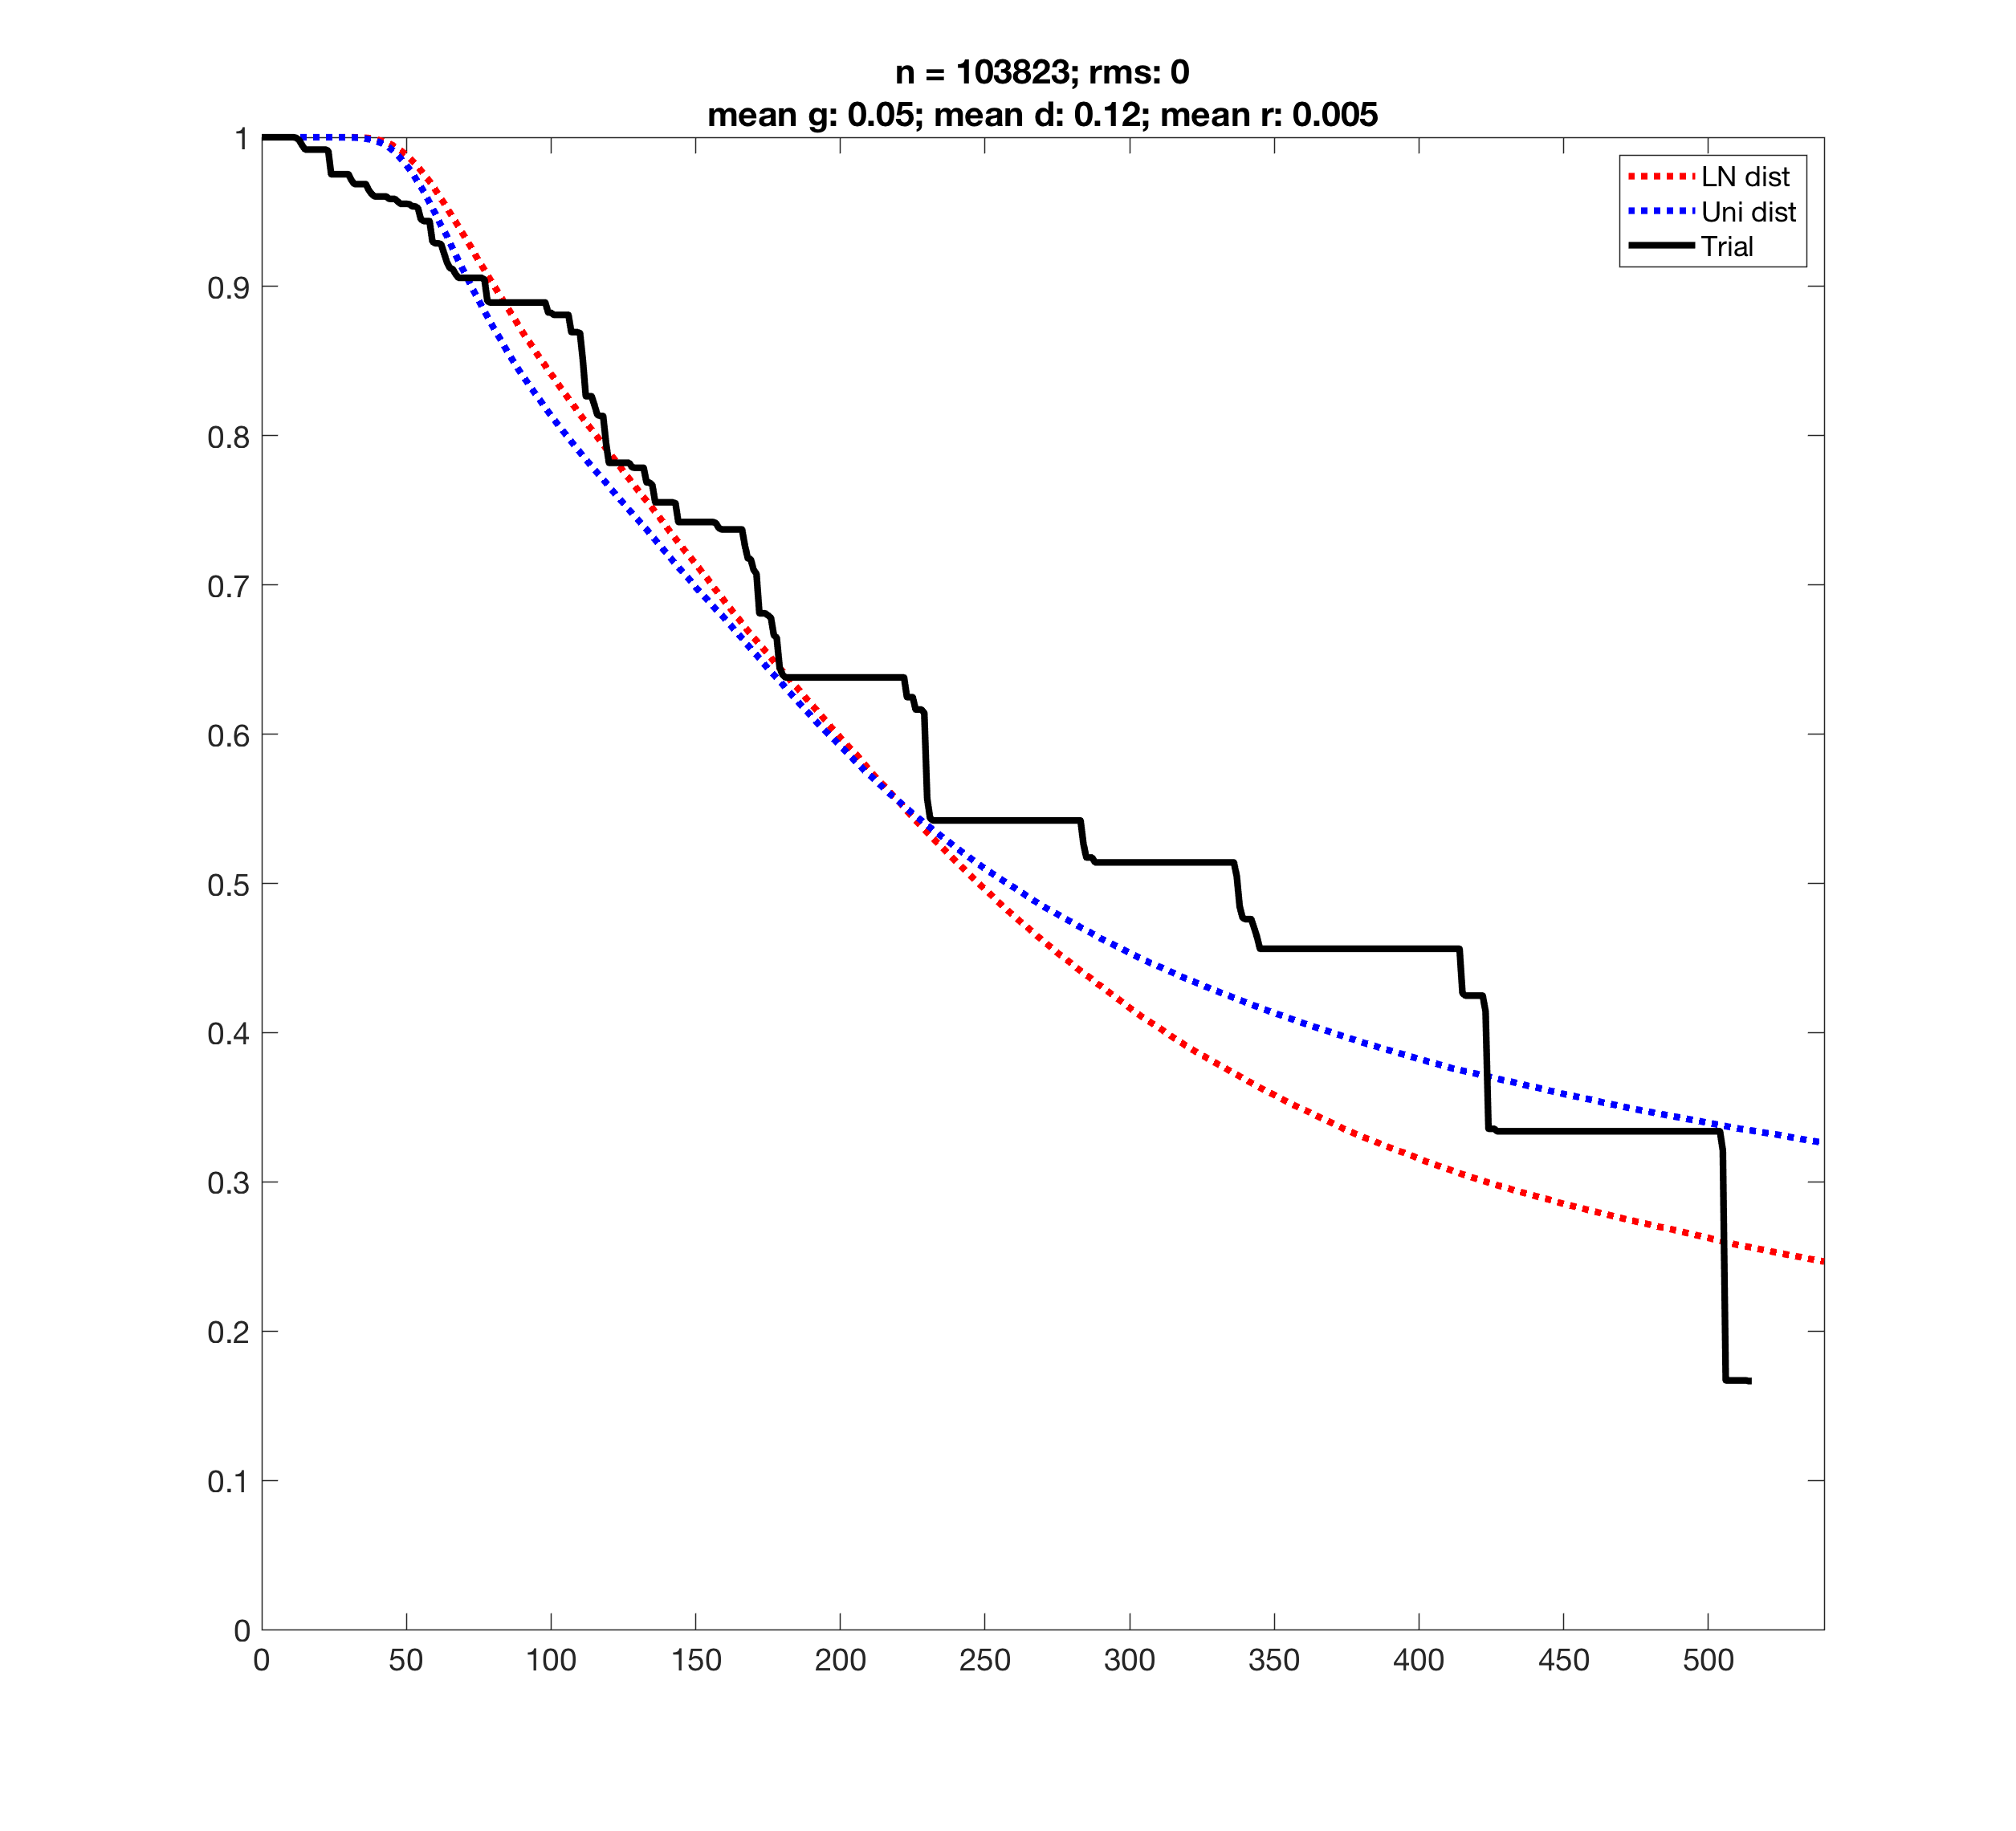
The effect of distribution shapes
Comparing linear versus log-normal distributions shows minimal differences, if the mean and std are matched, and N is large enough

Slide 20
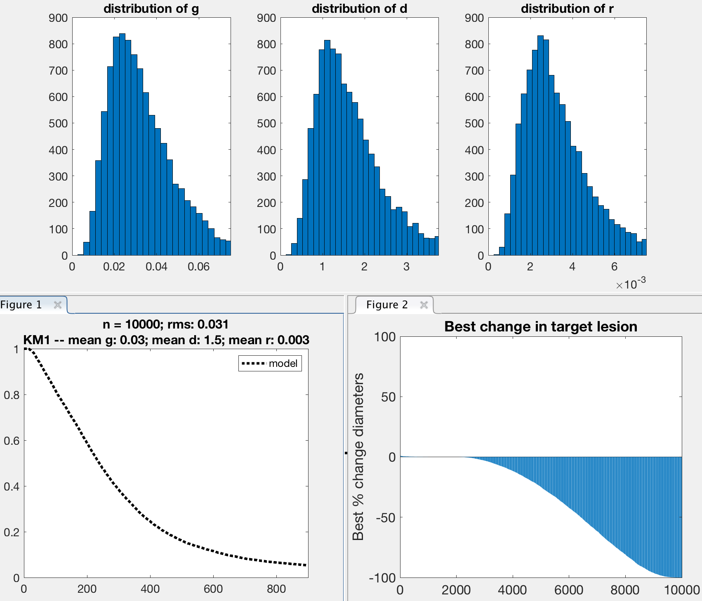
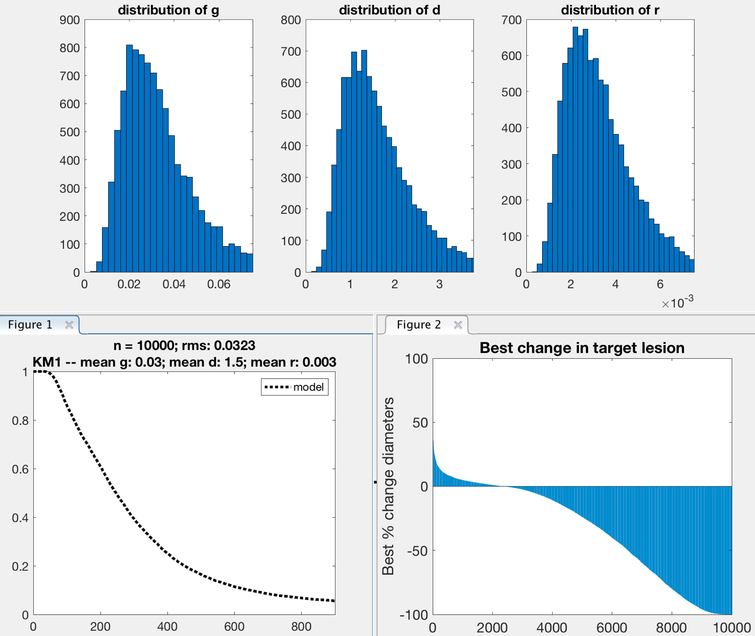
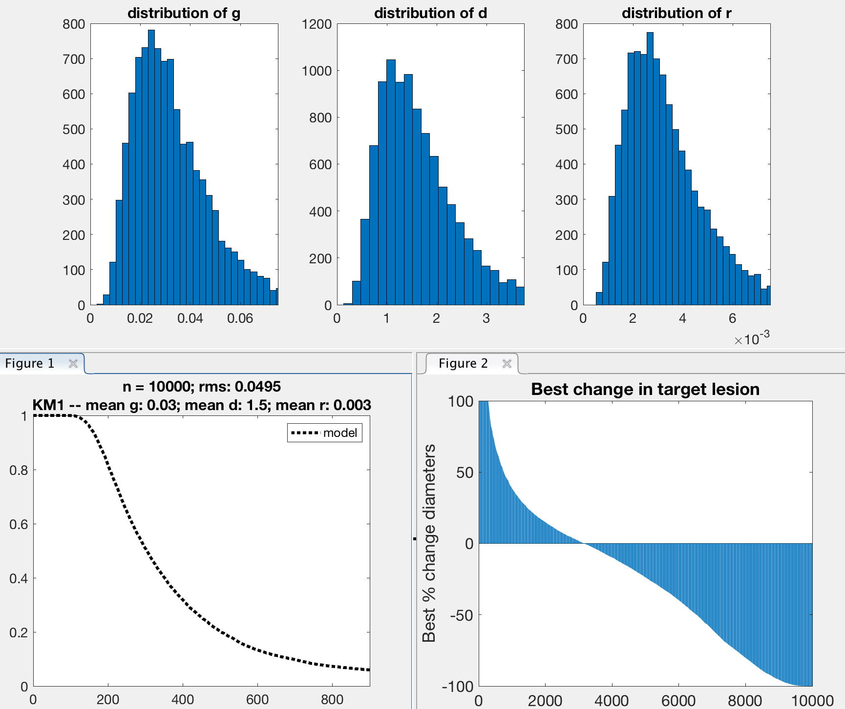
The effect of imaging
In the approach, we apply imaging as in the clinic, sampling the solution with the frequency used in the trial, plus some (significant) noise
The net effect of slower imaging is to shift the PFS curve rightward, especially in the first months; and it also increases the left side of the response plot
There is also a detection threshold involved
instantaneous
3 week interval
3 month interval

Slide 21
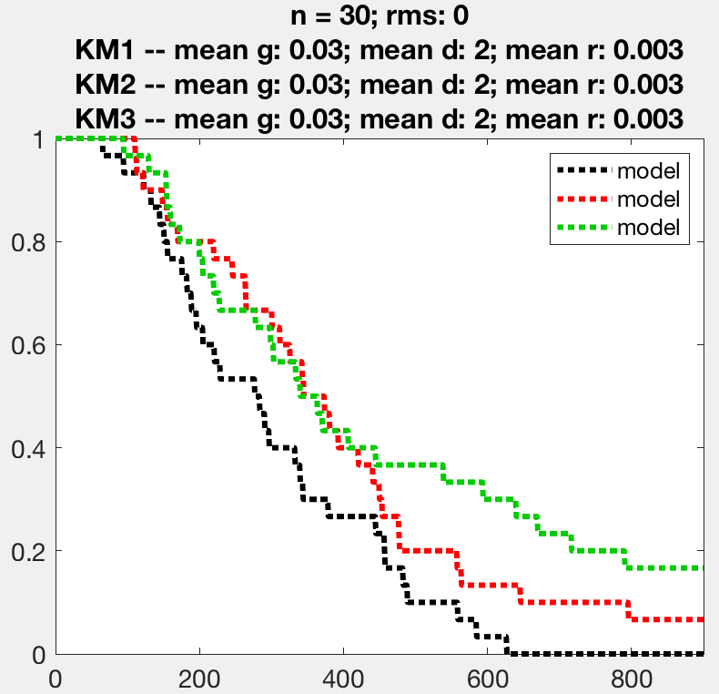
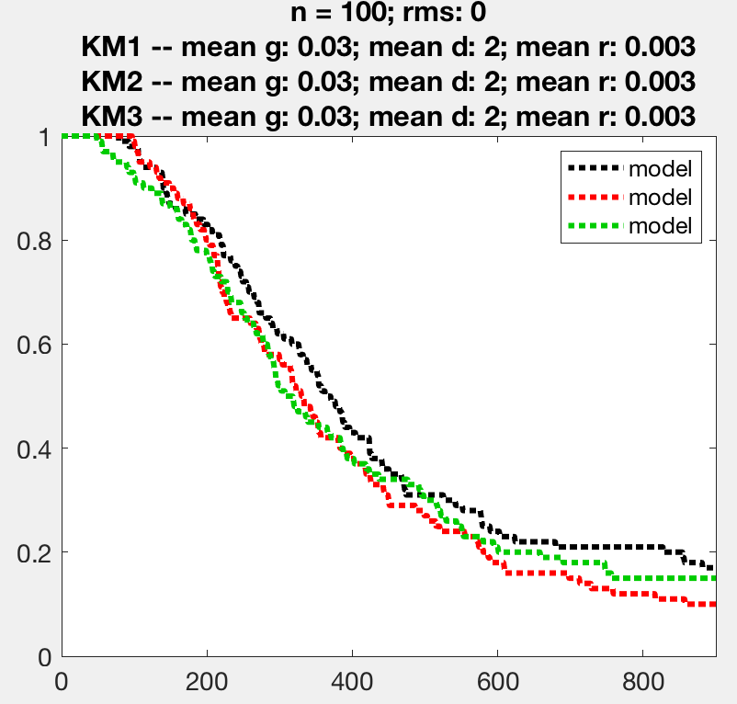
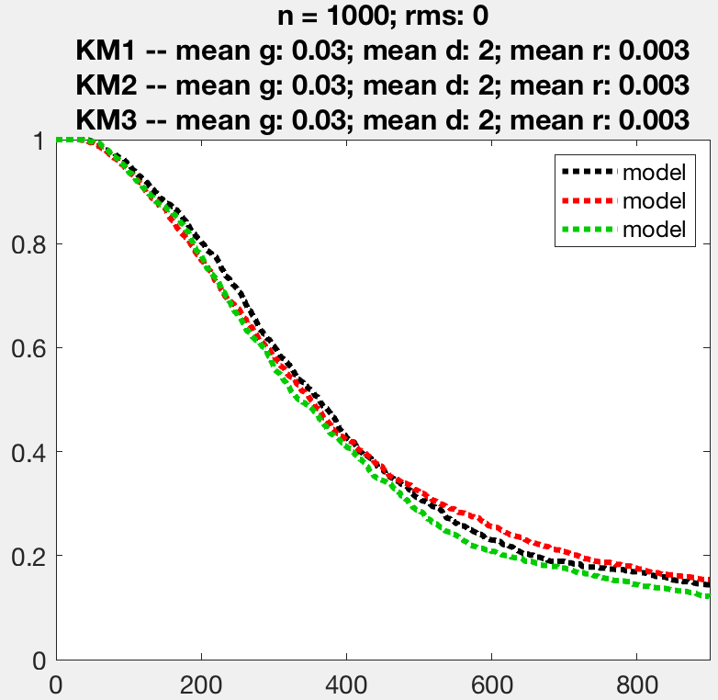
The effect of cohort size
Variation between Phase-i trials depends on number of virtual patients, as well as the variance in parameters
Shown here are distributions with a large variance, for three different virtual cohort sizes (all cohort parameters equal), showing three repeats
N=30
N=100
N = 1000

Slide 22
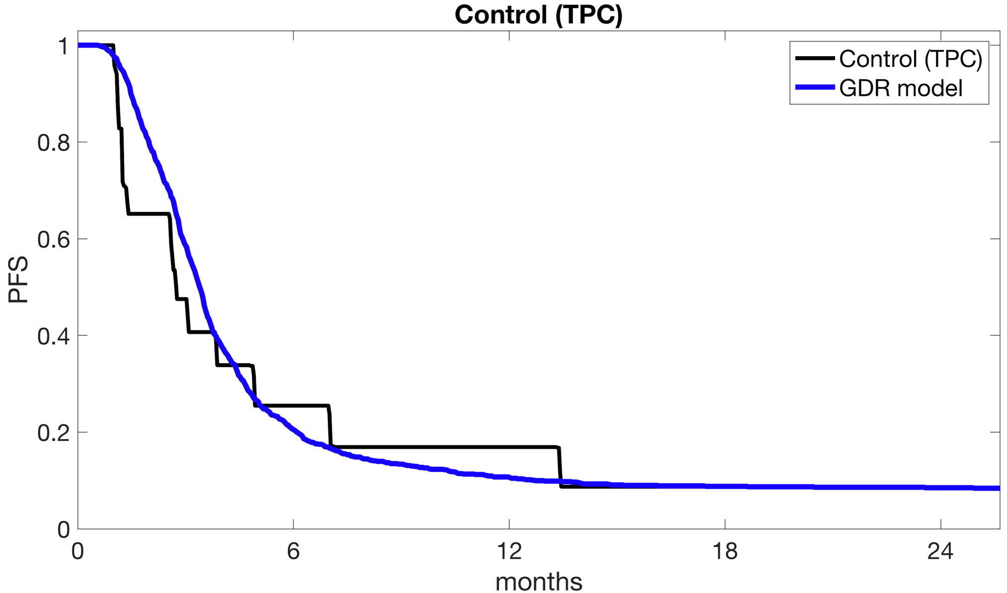
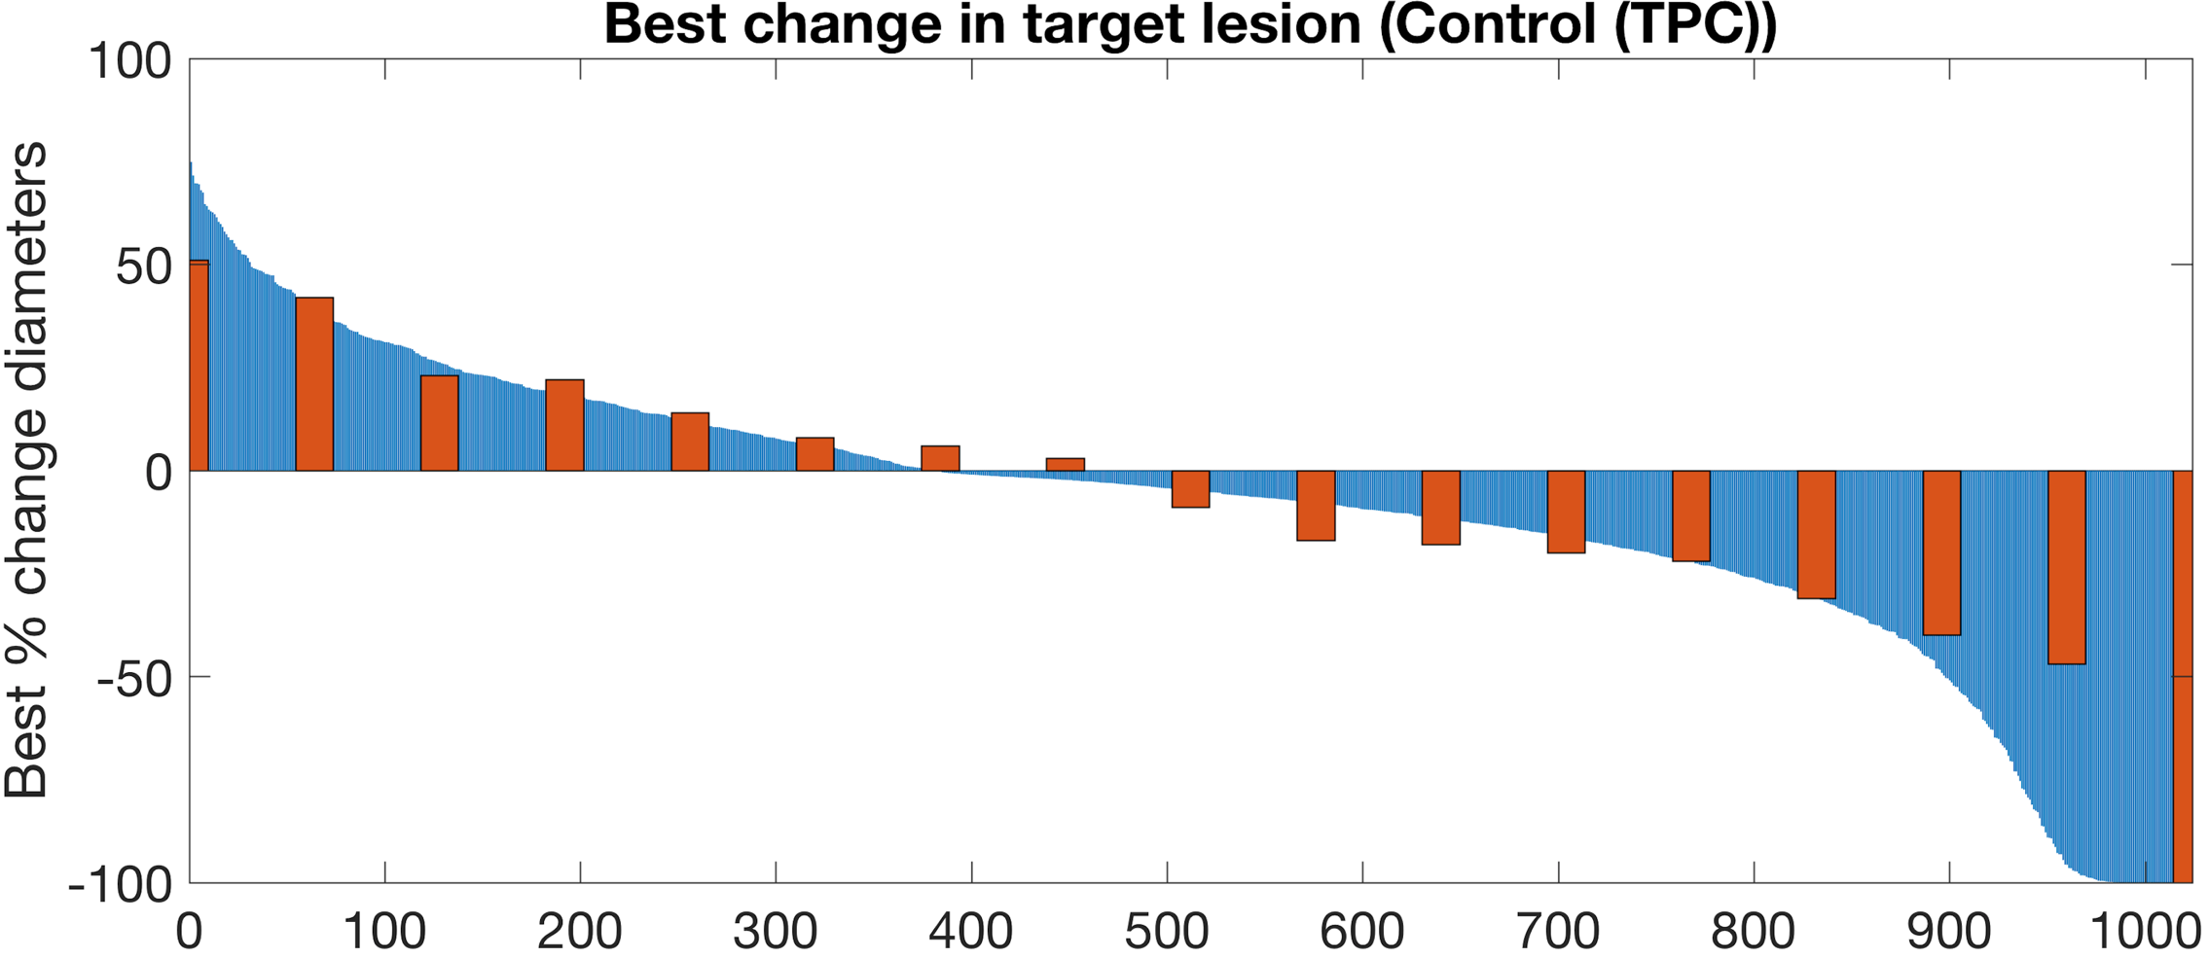
Control group (TPC)
PFS in the model determined as in the clinic: 20% increase on imaging
Best change in the model is lowest tumor volume identified on imaging (nadir for PR/SD, or first scan for progressors)
Real cohort (n=17)
Virtual cohort (n=1024)

Slide 23
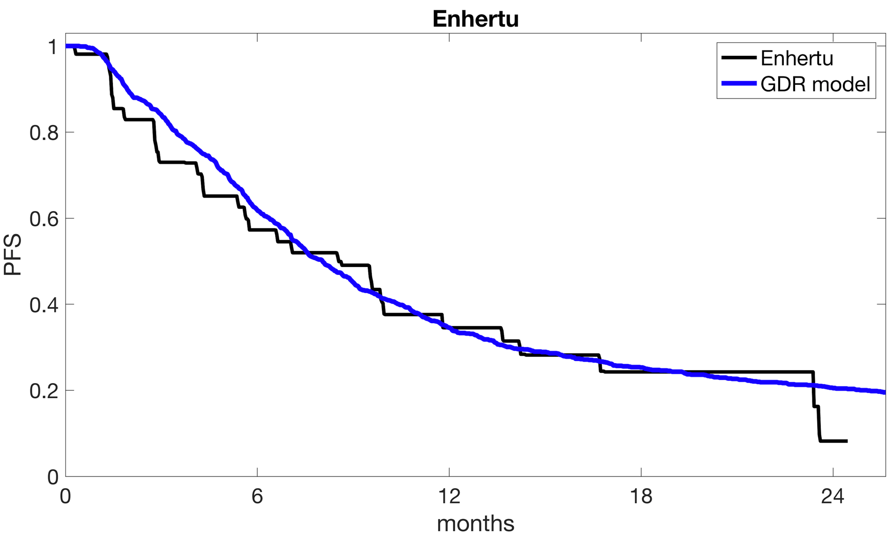
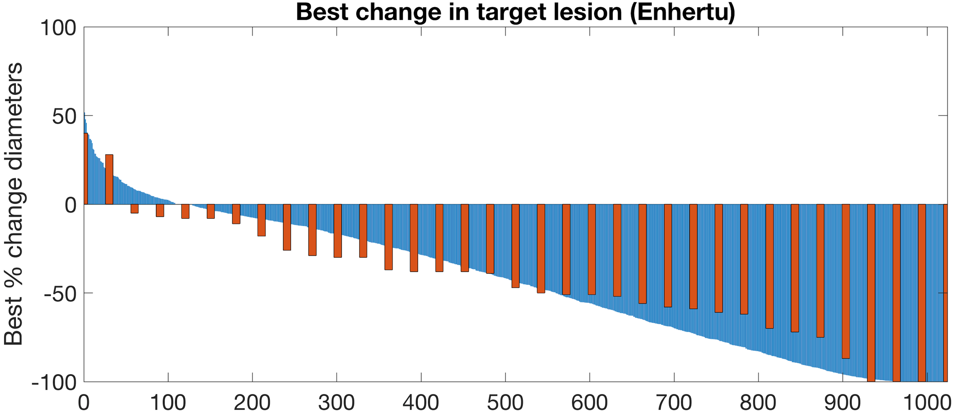
Enhertu group
PFS in the model determined as in the clinic: 20% increase on imaging
Best change in the model is lowest tumor volume identified on imaging (nadir for PR/SD, or first scan for progressors)
Real cohort (n=35)
Virtual cohort (n=1024)

Slide 24
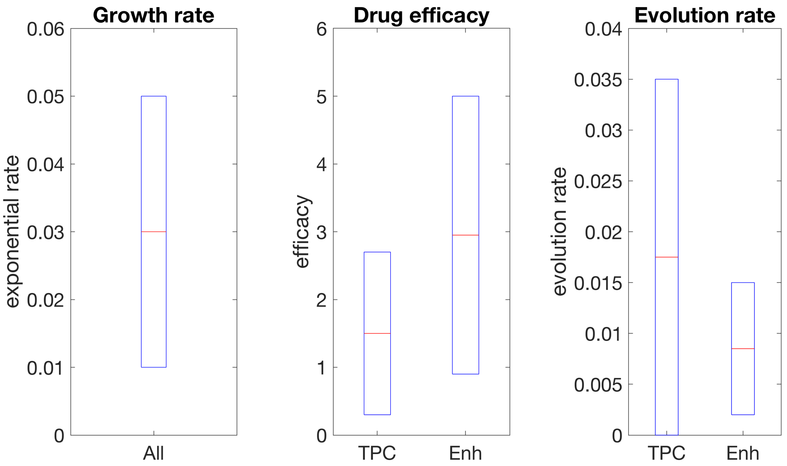
Comparison
Rate of evolution
of resistance
Growth rate Drug efficacy
Range of tumor growth rates for both cohorts set equally
Efficacy and evolution rate can be compared for the 2 representative virtual cohorts
Model predicts double efficacy and half the evolution rate as TPC cohort therapies

Slide 25
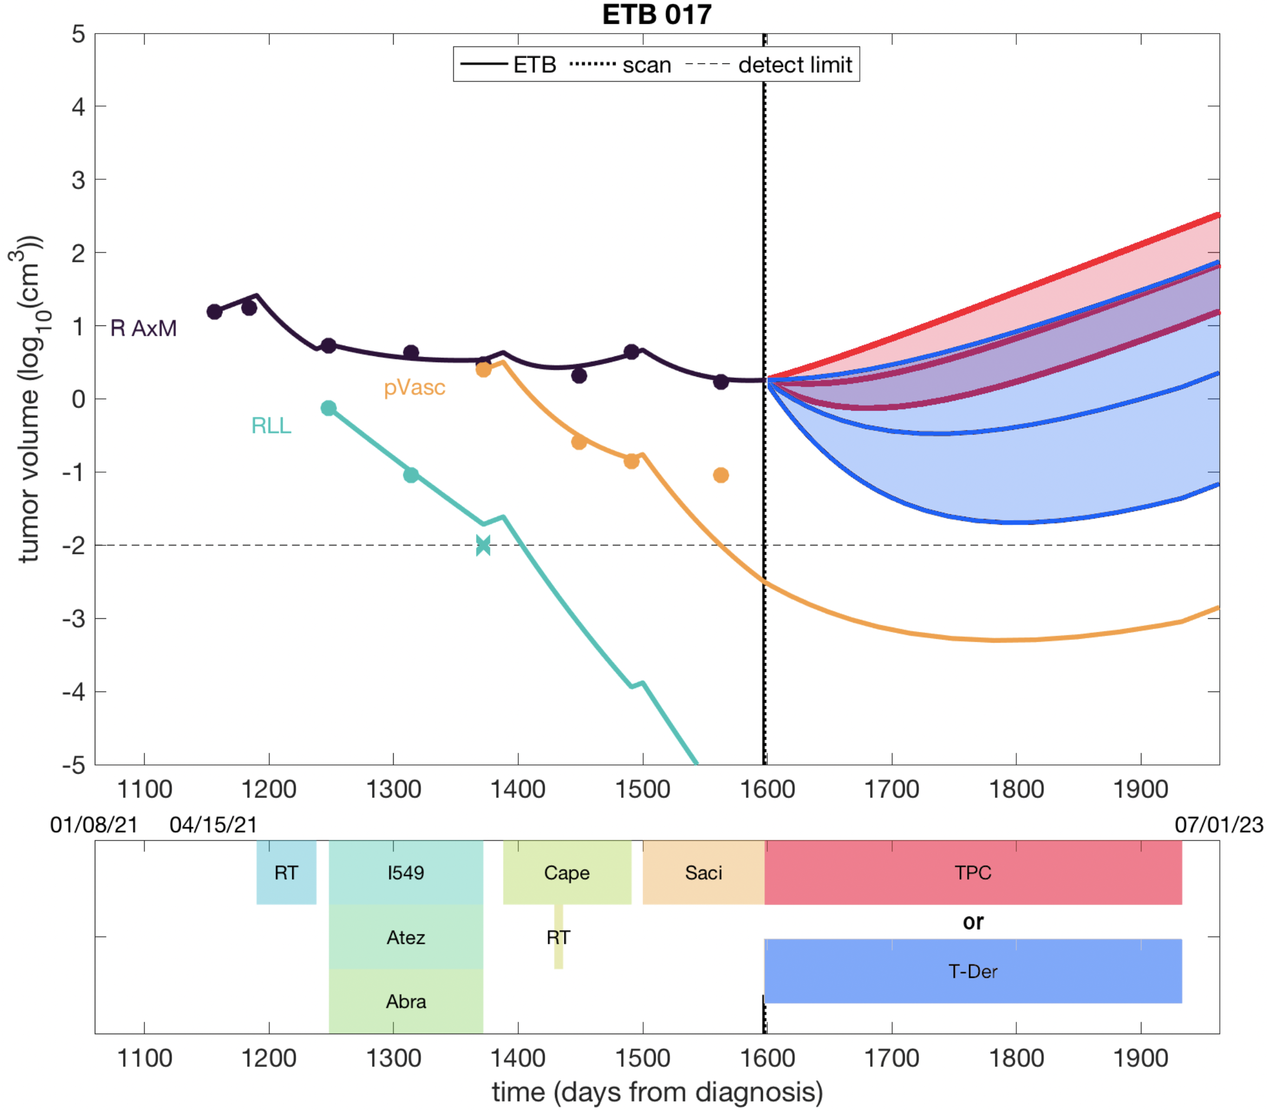
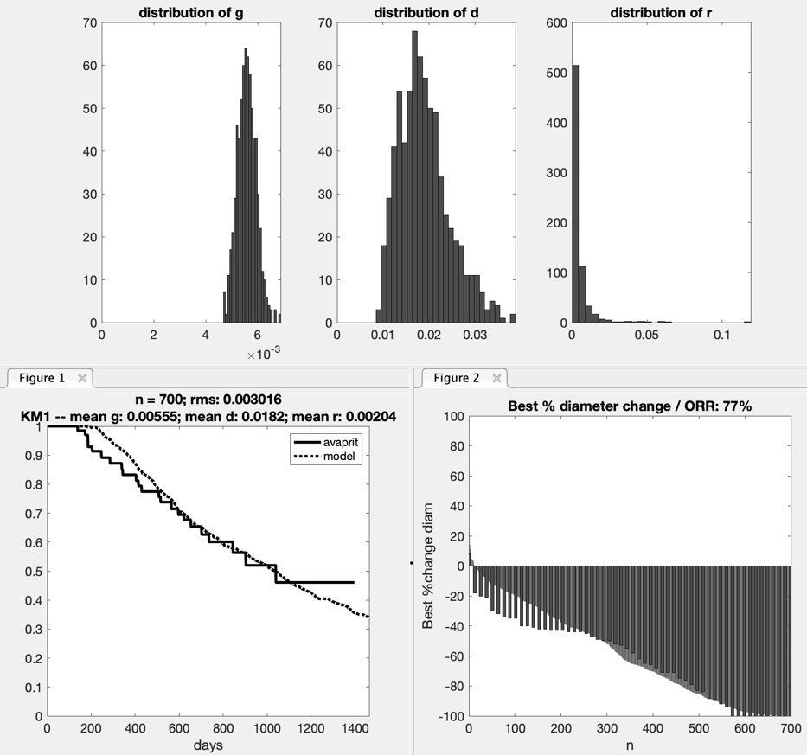
Trial-informed predictions

Slide 26
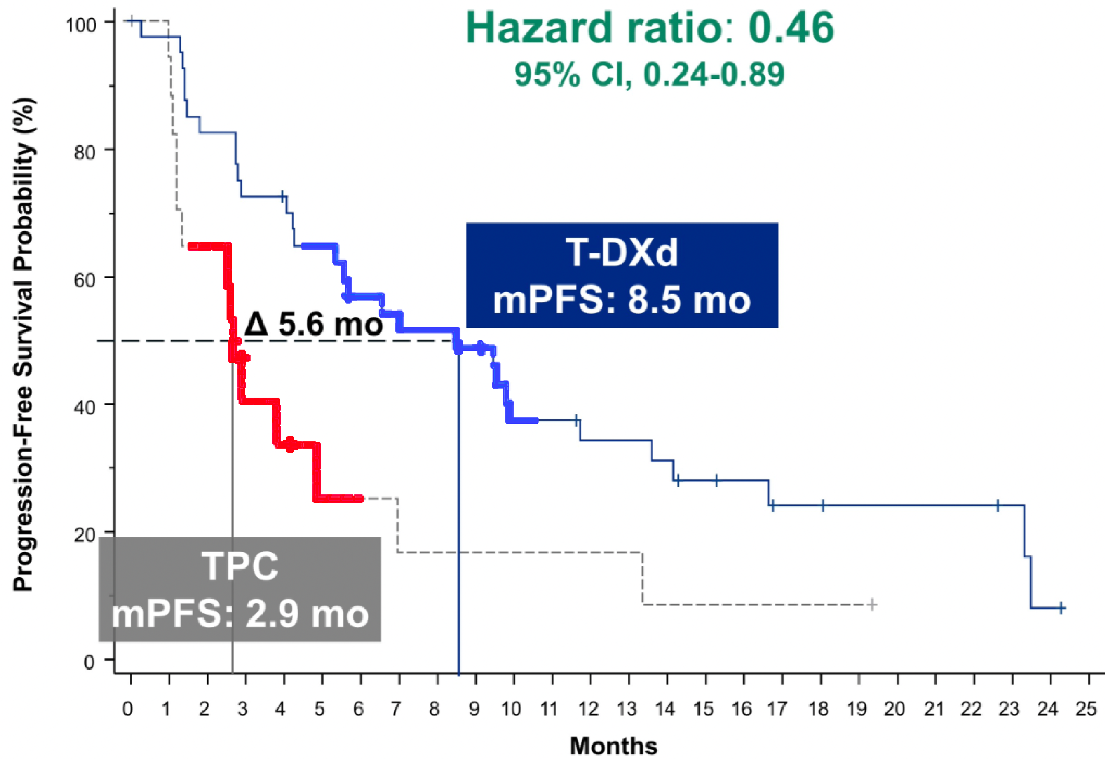
Patient-specific PFS predictions
Expected range of patient PFS curves for T-DXd (blue) and TPC (red)
PFS (mo) | TPC | T-DXd
Min | 1.6 | 4.6
Avg | 4.3 | 8.5
Max | 6.0 | 10.6
TTN (mo) | TPC | T-DXd
Min | 0 | 0.1
Avg | 1.5 | 5.0
Max | 3.1 | 7.2

Slide 27
Virtual Patient opportunities
Analysis platform for retrospective clinical data and mathematical models
Derive insight on disease dynamics and patient heterogeneity
Continuously update disease libraries to incorporate new drugs & biomarkers
Virtual clinical trial framework for translating pre-clinical data
Test novel agents or combinations in virtual trials
Use virtual patient libraries developed from real patients
Framework for evolutionary therapy clinical trial design
Use virtual cohorts to derive optimal trial design to maximize outcomes
Identify data collection protocols that exploit clinical information
Treatment navigation (decision support) for individual patients
Provide decision support in real-time based on individual patient data
Uses retrospective data to incorporate uncertainty

Slide 28
Discussion and Questions

